Slide 1
ENERGY CONSUMPTION FORECASTING
GROUP NO – 9
NAVEEN SAI
HARSHA REDDY
RITHIKA
LOHITH REDDY

Slide 2
INTRODUCTION
Energy consumption forecasting is vital for balancing electricity production and usage, preventing grid failures, and ensuring efficient resource allocation.
With increasing energy demand and the integration of renewable energy sources, accurate prediction models are essential for sustainability and operational efficiency.
This project leverages machine learning techniques to predict energy consumption based on historical data and external factors like weather conditions.
By evaluating and comparing various algorithms, we aim to develop a robust predictive tool that enhances energy planning, reduces costs, and supports real-time decision-making.

Slide 3
MODELS USED
Linear Regression
Decision tree Regression
Random forest Regression
Support vector machine
Why we used only regression models?
Energy consumption is measured in continuous values (e.g., kilowatt-hours), which is ideal for regression. Regression models are specifically designed to handle numerical outputs.

Slide 4
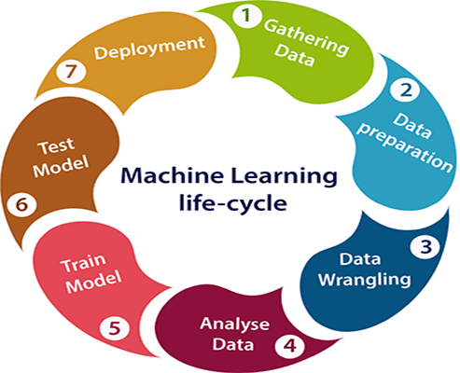
STEPS INVOLVED
DATA COLLECTION
DATA PREPROCESSING
MODEL SELECTION
TRAINING THE MODEL
MODEL EVALUATION

Slide 5
PREPROCESSING METHODS
Removing non features
Encoding categorical values to numerical values:
Label Encoding
Ordinal encoding
Outlier detection
Imputation of missing values

Slide 6
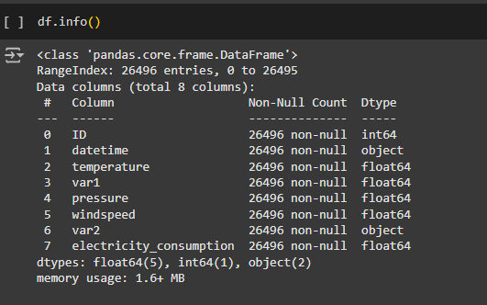
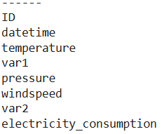
DATASET -1
Total no. of features: 7
No. of instances: 26495
Features:

Slide 7
time feature is divided into 6 features which are :
Year
Month
Day
hour
hour_sin
hour_cos
month_sin
Month_cos
By using hour_sin, hour_cos, month_sin and month_cos, you ensure the model captures the inherent cyclic structure of the hour and month feature, improving prediction accuracy.
There are no null values in the dataset
Removed the all outliers.

Slide 8
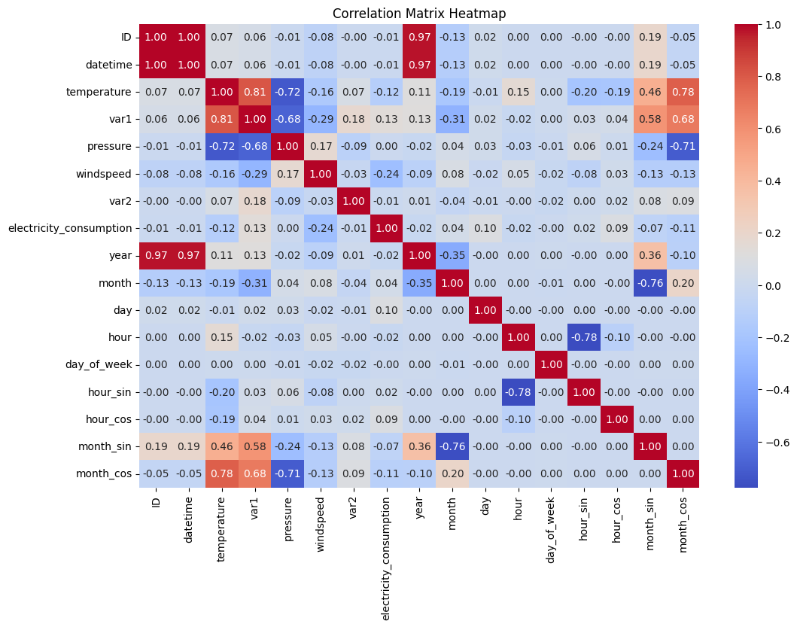

Slide 9
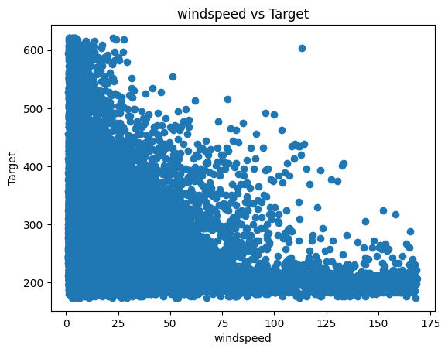
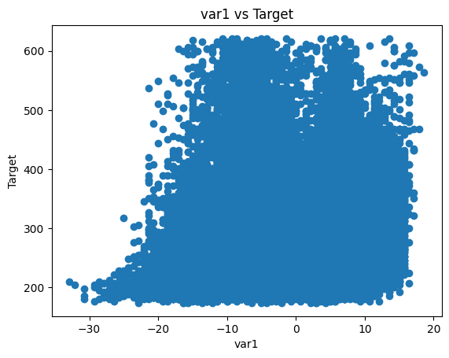
Scatter Plot

Slide 10
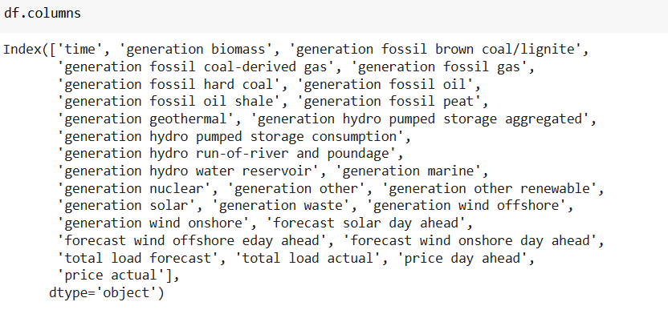
DATASET -2
Total no. of features: 29
No. of instances: 35064

Slide 11
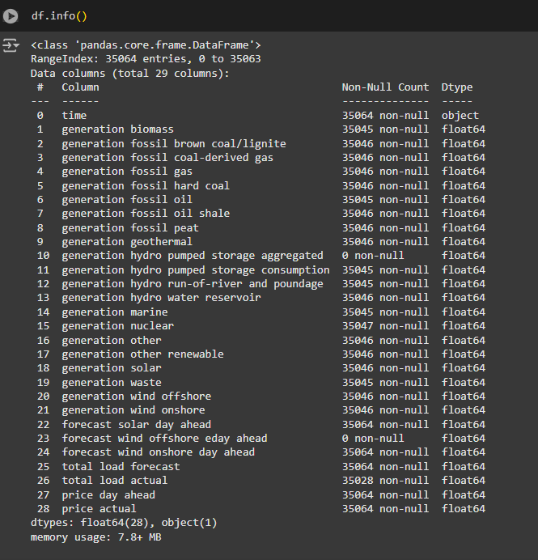

Slide 12
Time feature is divided into 6 features which are :
Year
Month
Day
Hour
day_of_week
is_weekend
hour_sin
hour_cos
month_sin
month_cos

Slide 13
We dropped forecast wind offshore eday ahead, generation hydro pumped storage aggregated because they are filled with null values entire rows.
And we deleted the rows if we found out any null values because the null values we found are about 0.5% so instead of imputing we choose to drop
By using hour_sin, hour_cos, month_sin, month_cos you ensure the model captures the inherent cyclic structure of the hour feature and month feature, improving prediction accuracy.
We dropped forecast solar day ahead, forecast wind onshore day ahead, generation other renewable features because it is highly co-related with the generation solar, generation wind onshore and year features, so we can choose any one feature.
Removed all the outliers.

Slide 14
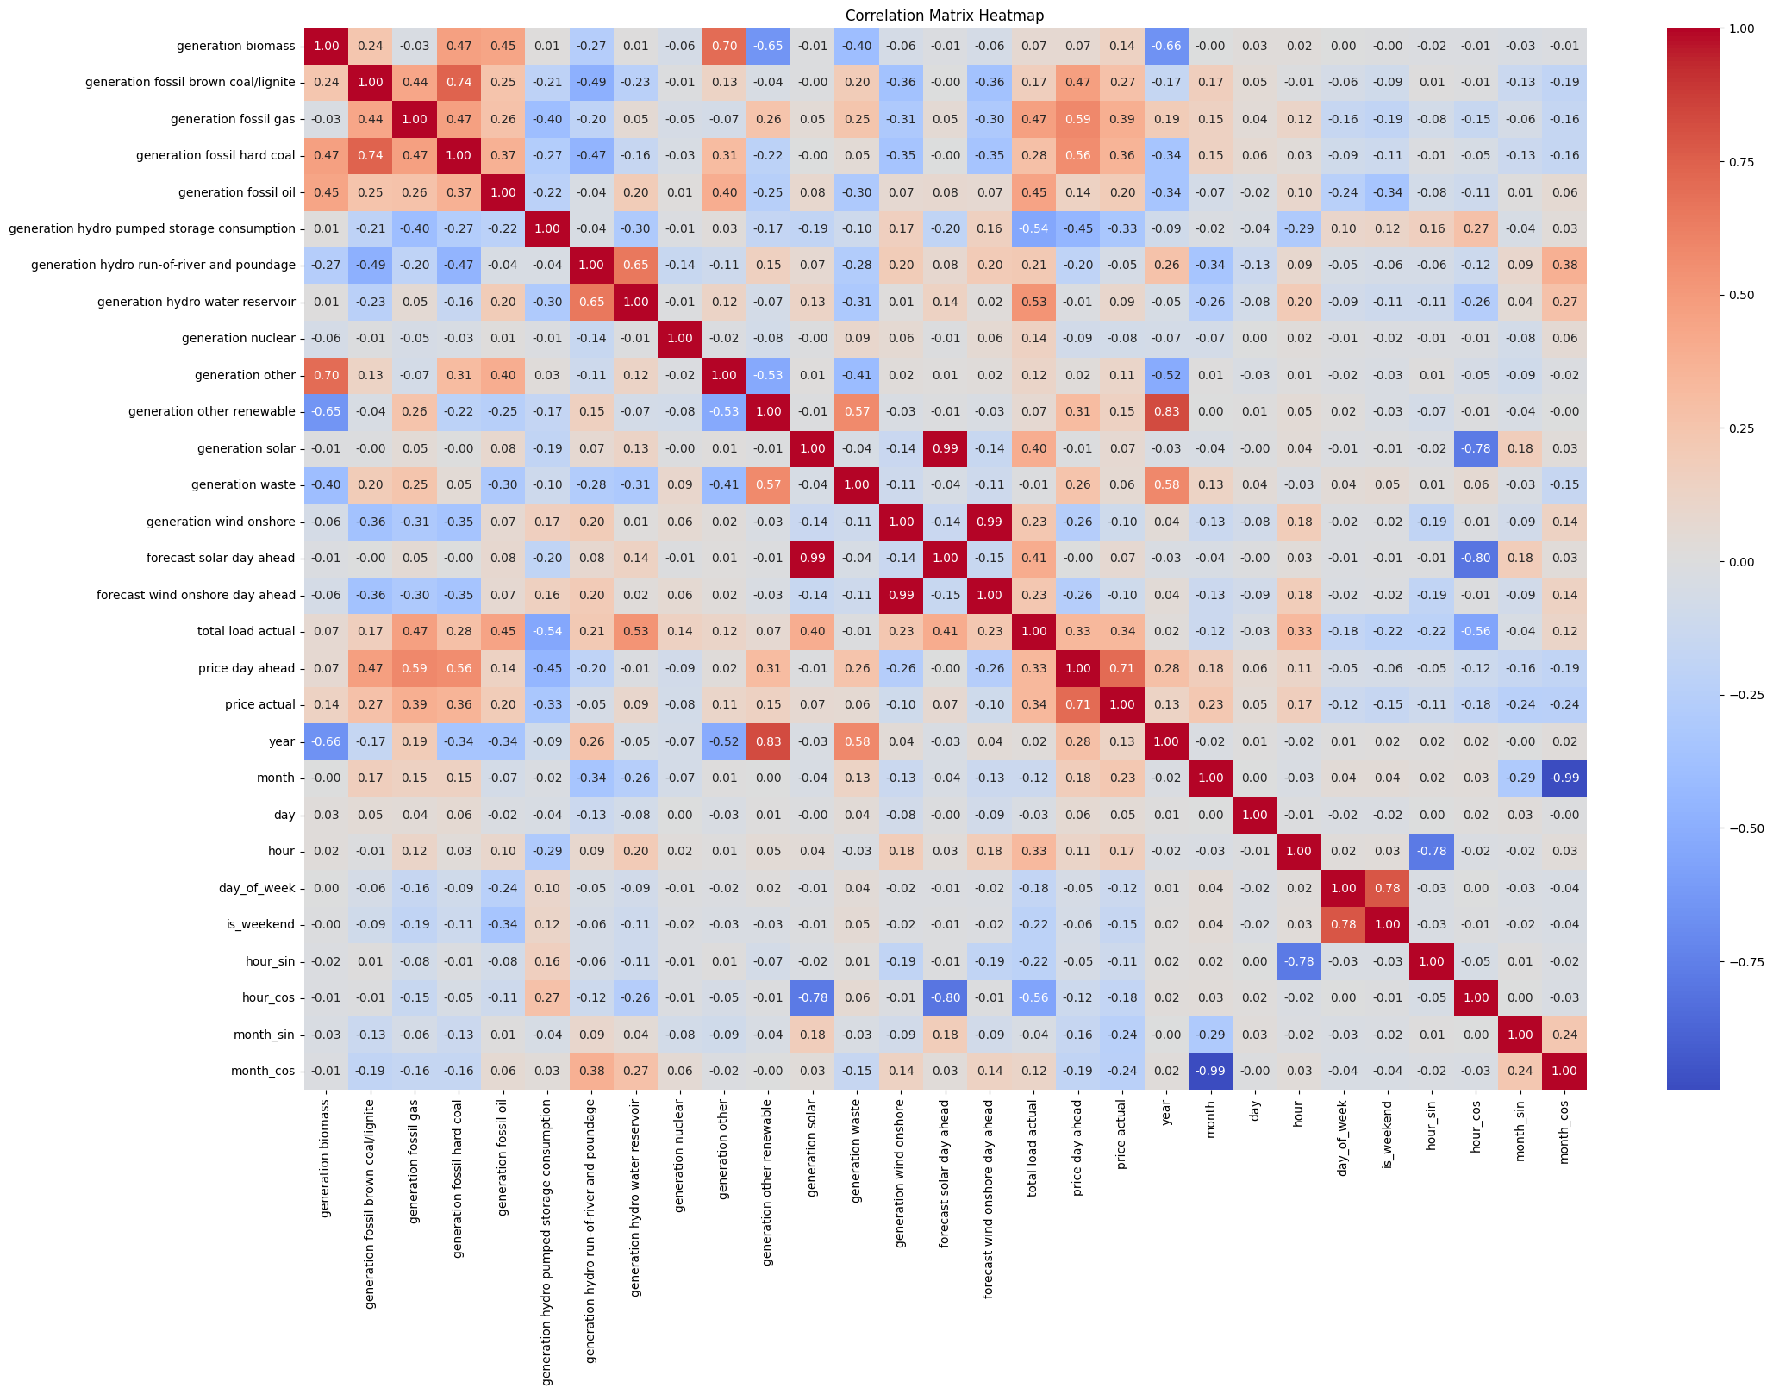

Slide 15
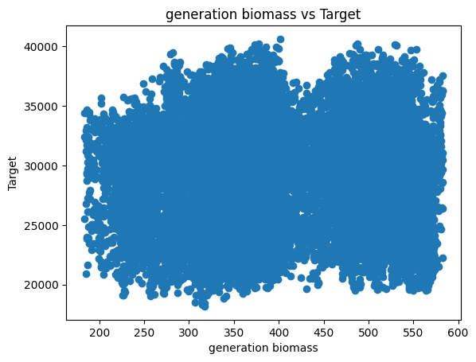
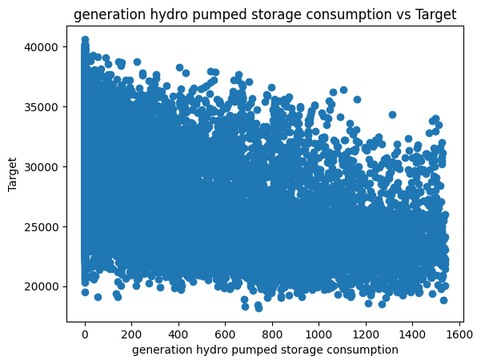
Scatter Plot

Slide 16
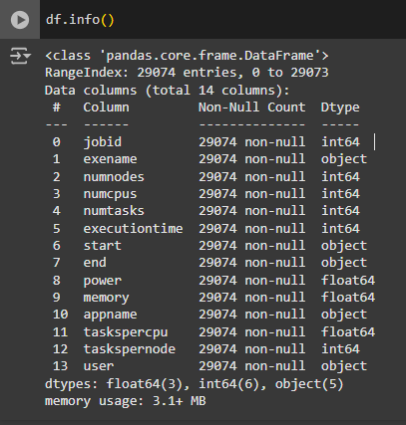
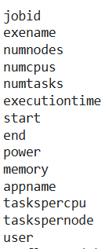
DATASET -3
Total no. of features: 14
No. of instances: 29074
Features :

Slide 17
In this dataset one feature contains the addition of time which is recorded as start time and end time so there is no need to start time so I dropped the start_time and end_time features.
And I dropped the job_id which is unique for every row
There are no null values in the dataset
Encoded the categorical values.
We dropped numcpus, numnodes feature because it is highly co related with the numtasks feature, so we can choose any one feature. Same apply to exename and appname.

Slide 18
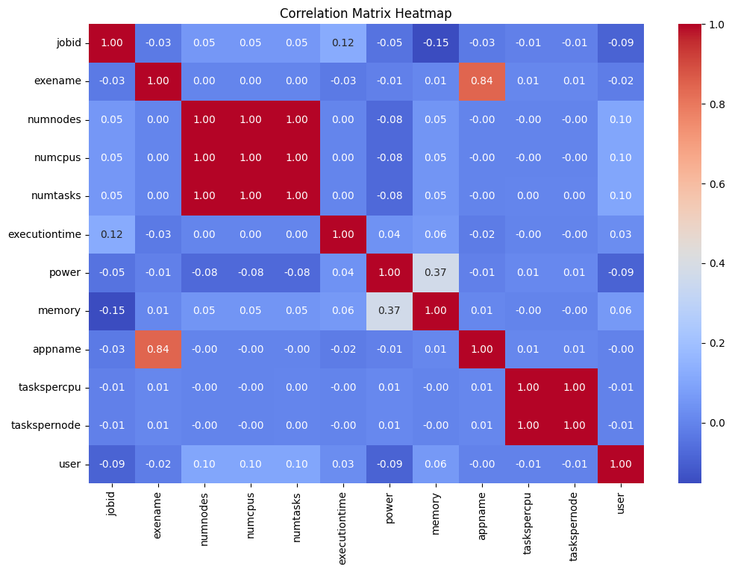

Slide 19
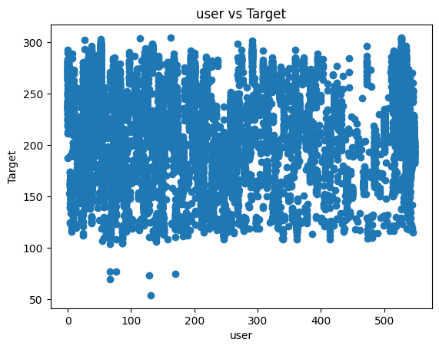
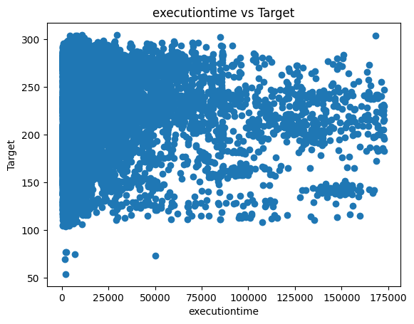
Scatter Plot

Slide 20
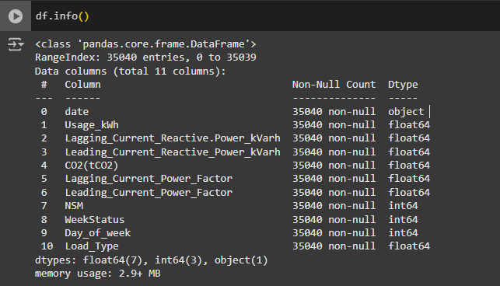
DATASET -4
Total no. of features: 11
No. of instances: 35040
Features :
Date
Usage_kwh
Lagging_Current_Reactive.Power_kVarh
Leading_Current_Reactive_Power_kVarh
CO2(tCO2)
Lagging_Current_Power_Factor
Leading_Current_Power_Factor
NSM
WeekStatus
Day_of_week
Load_Type

Slide 21
Date feature is divided into 6 features which are :
Year
Month
Day
hour
hour_sin
hour_cos
By using hour_sin and hour_cos, you ensure the model captures the inherent cyclic structure of the hour feature, improving prediction accuracy.
We dropped the year column because our dataset contains the data of only one year.
We dropped nsm feature because it is highly co related with the hour feature, so we can choose any one feature.
There are no null values in the dataset
Encoded the categorical values.

Slide 22
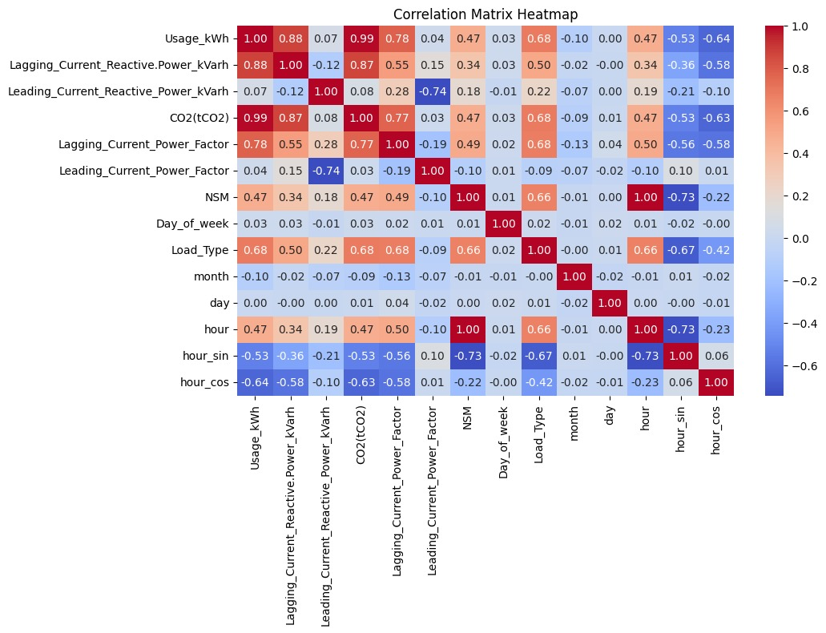

Slide 23
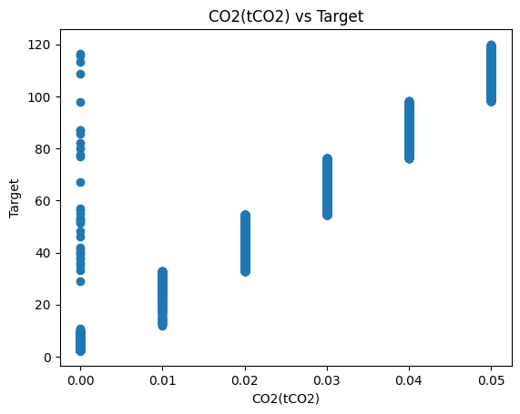
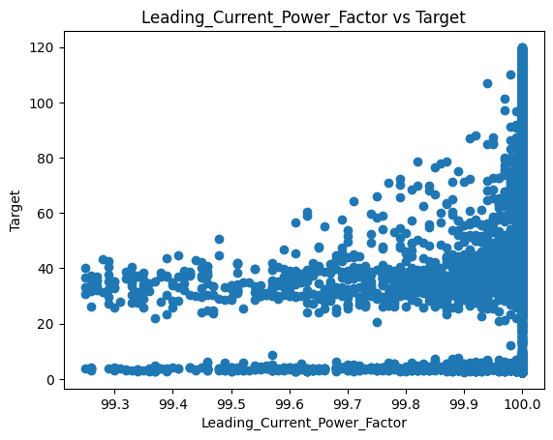
Scatter Plot

Slide 24

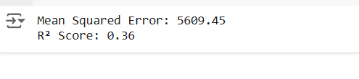


Linear Regression
Dataset 1:
Dataset 2:
Dataset 4:
Dataset 3:

Slide 25

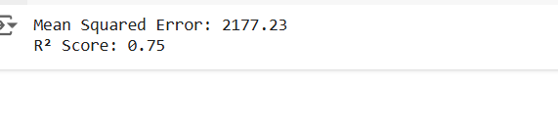


Random Forest Regression
Dataset 1:
Dataset 2:
Dataset 4:
Dataset 3:

Slide 26




Decision Tree Regression
Dataset 1:
Dataset 2:
Dataset 4:
Dataset 3:

Slide 27





Support Vector Machine Regression
Dataset 1:
Dataset 2:

Slide 28






Support Vector Machine Regression
Dataset 3:
Dataset 4:

Slide 29
THANK YOU

